Slide 1
User Generated Content and Product Comparison Networks Part II
User Generated Content Analytics
October 3, 2017

Slide 2
Roadmap for the Rest of the Course
Technical
Clustering with user generated content
Topic modeling
Resonance analysis
Design of crowdsourced recommendation systems
Influence and network analysis

Slide 3
Roadmap (Continued)
Strategic
Best practices: Cisco, Ford, Masterfoods
ROI studies: Resident Evil 5, upgrading to premium level (online music service)
Increasing engagement on social platforms

Slide 4
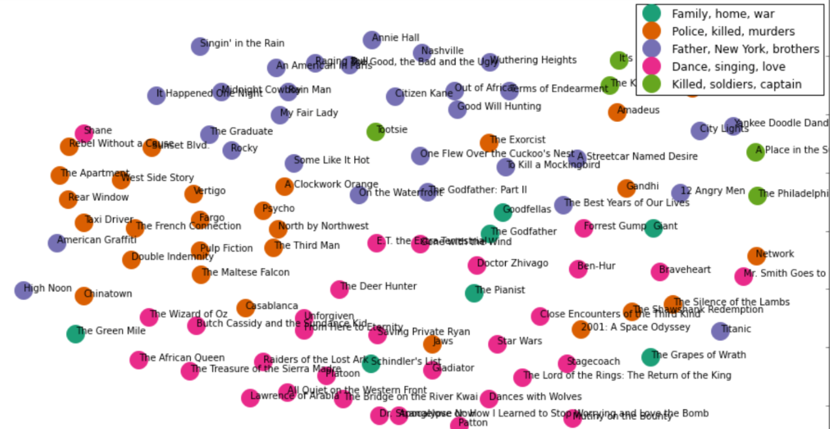
Coming Up (10/05): Clustering with UGC
Source: http://harrywang.github.io/document_clustering/

Slide 5
Predictions from User Generated Content (contd.)
Multiple product mentions → Sentiment extraction → Preference Network → Weighted PageRank score for each product
Why weighted?
Implications
Useful for predicting sales of new products
Assessing where switching will occur from
A product gets more visibility if seen with preferred products

Slide 6
Would Simple PageRank Do the Job?
Possibility of over-connected preference network
Need to make it sparse by using threshold value
Still can’t do as well as weighted PageRank scores
Would lift be a good indicator of sales?

Slide 7
Assignment #2 (More Guidelines)
Separate searches with one keyword at a time
Find lists of US cities and 50 states from Google search
Replace with USA001 and Rest_of_the_world
Concatenate location data & tweets (for location based analysis)
For Bitcoin, Ethereum and attributes, create a single Lift matrix
A line of fake data with Bitcoin, Ethereum and all attributes mentioned.
Use parserforsentiment.py to extract parts relevant to a brand and attribute (e.g., Bitcoin & fraud)
Then use Vader sentiment analyzer (sentiment.py)

